Slide 1
Advanced Algorithms Session 1
Gorkem Kar

Slide 2
Contents
Introduction
Grading
Basic Concepts
Efficiency
Complexity

Slide 3
Introduction
Dr. Gorkem Kar
PhD. From Rutgers University, USA
Worked in Turkey for 5 years
2nd year at UCM
kar@ucmo.edu
MIC D-159
Email me for 1-1 visits in my office

Slide 4
Grading
Attendance (%10)
Participation (%15)
Midterm Exam (%25)
Quizzes (%30)
Final Exam (%30)
80+ points: A
70-79 points: B
60-69 points: C
<60 points: D or F

Slide 5
Basic Concepts
Algorithm
Flowchart representation
Pseudocode

Slide 6

Algorithm - 1
Notes:
https://www.youtube.com/watch?v=AVScy7YsKM0

Slide 7
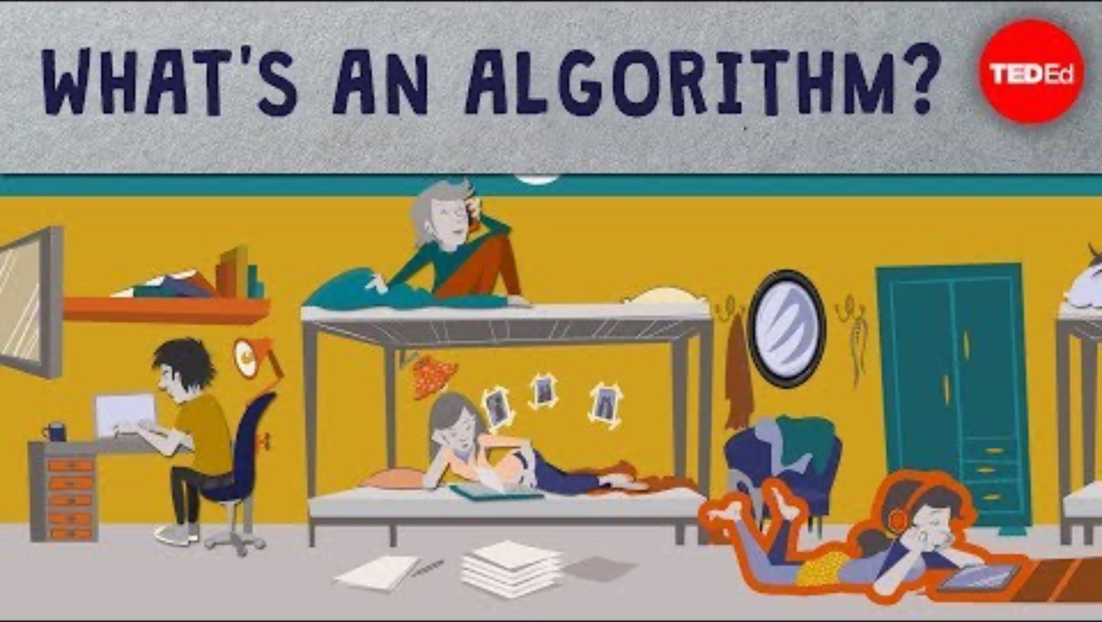
Algorithm - 2
Notes:
https://www.youtube.com/watch?v=6hfOvs8pY1k

Slide 8




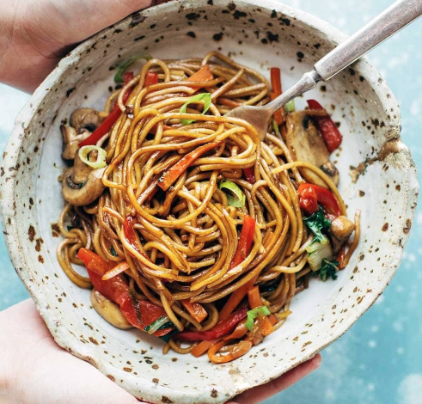

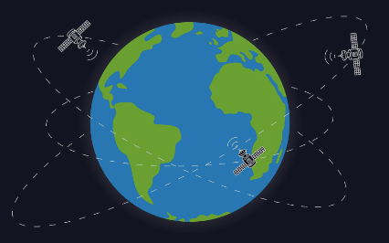

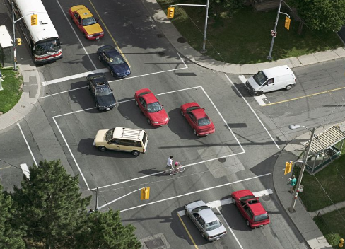
Algorithm Examples
Recipes
Sorting papers
Traffic signals
Bus schedules
GPS
Facial recognition
Spotify
Google search
Online shopping

Slide 9
Flowchart
Graphical representation
Symbols, shapes and arrows
Demonstration purpose
Notes:
It is a graphical representation of an algorithm with the help of different symbols, shapes, and arrows to demonstrate a process or a program.

Slide 10
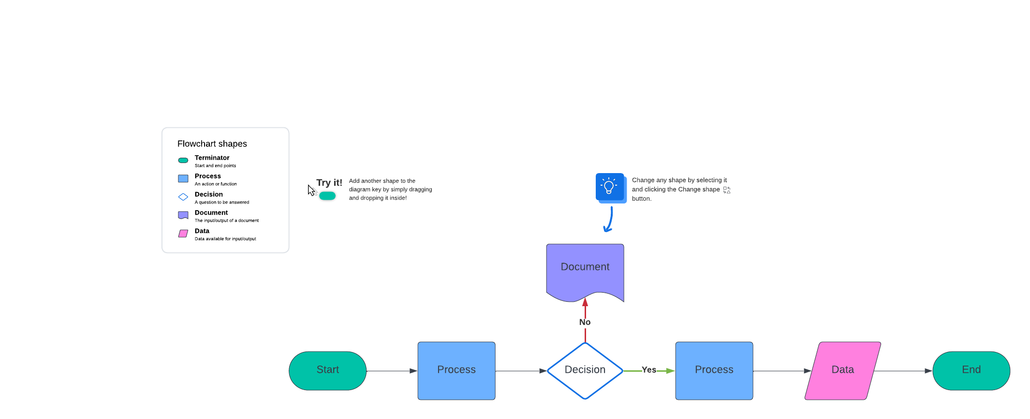
Flowchart Free Website
Lucid.app
Notes:
Terminal box – Start/End
Input / Output
Process / Instruction
Decision
Connector / Arrow

Slide 11
Flowchart Example
Compute the average of three numbers
Start
Declare variables (n1, n2, n3, avg)
Read values (n1, n2, n3)
Find the average using the formula
Display average
End

Slide 12
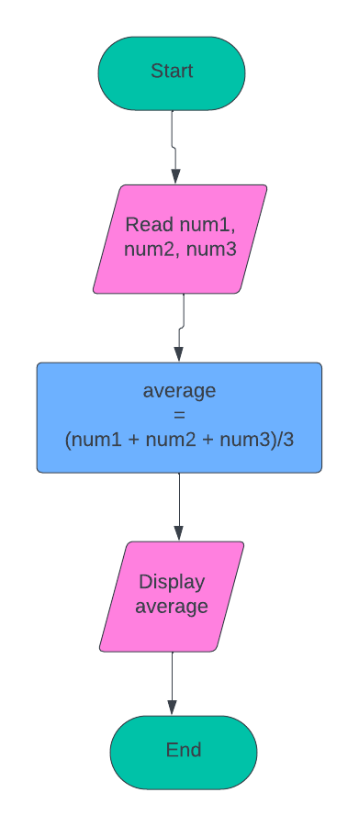
Flowchart Example
Notes:
Terminal box – Start/End
Input / Output
Process / Instruction
Decision
Connector / Arrow

Slide 13


Pseudocode
High-level description
English-like statements
Basic logic
Notes:
High-level description of an algorithm that uses simple, English-like statements to outline the basic logic.

Slide 14
Pseudocode Benefits
Simplified logic
Easier to communicate with noncoders
Save time & prevent mistakes
Notes:
High-level description of an algorithm that uses simple, English-like statements to outline the basic logic.

Slide 15
Pseudocode Steps
Understand the problem
Break down the problem into smaller steps
Write out the pseudocode
Test the pseudocode
Translate that into an actual code

Slide 16
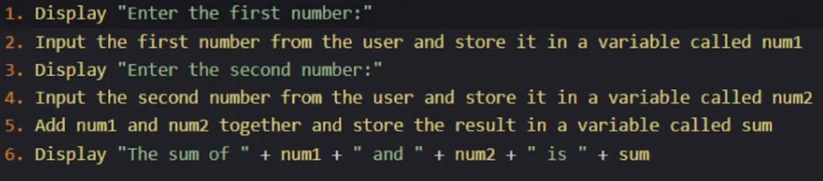
Pseudocode Steps Example
Task: Write a code that adds two numbers
Ask the user to enter both numbers
Do the addition
Display the summation

Slide 17
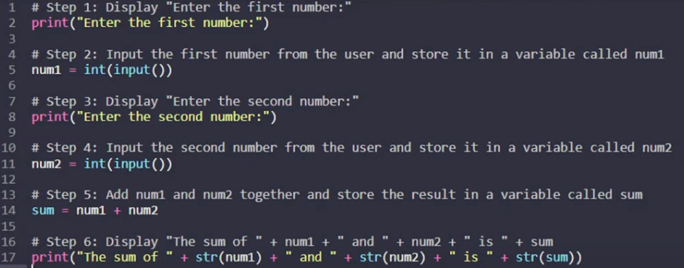
Example Code

Slide 18
Efficiency

Slide 19
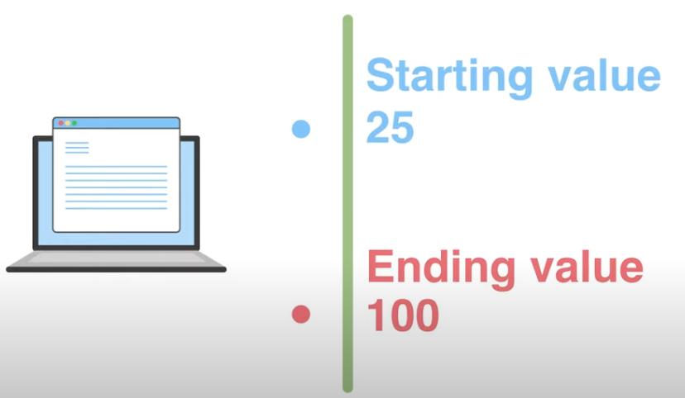
Growth Rate - 1
Notes:
Let’s say our blog has 25 subscribers at the end of March and has 100 subscribers at the end of April. What is the growth rate?

Slide 20
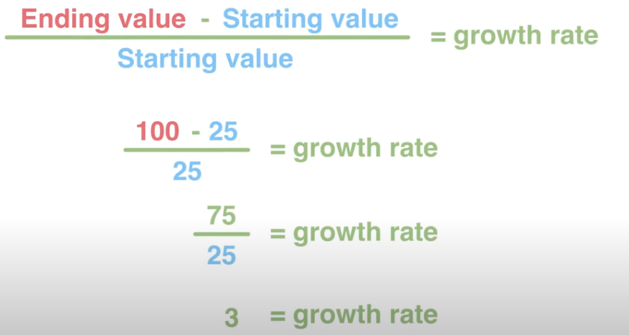
Growth Rate - 2
Notes:
3 x 100% = 300%

Slide 21
Efficiency
Worst Case Efficiency
Average Case Efficiency
Best Case Efficiency

Slide 22
Big-O Notation
Simplified analysis of an algorithm’s efficiency
Complexity in terms of input size, N
Machine-independent
Basic computer steps
Time & space

Slide 23
Big-O Notation General Rules
Ignore constants
5n -> O(n)
Certain terms “dominate” others
O(1) < O(log(n)) < O(n) < O(nlog(n)) < O(n²) < O(2^{n}) < O(n!) We ignore low-order terms

Slide 24
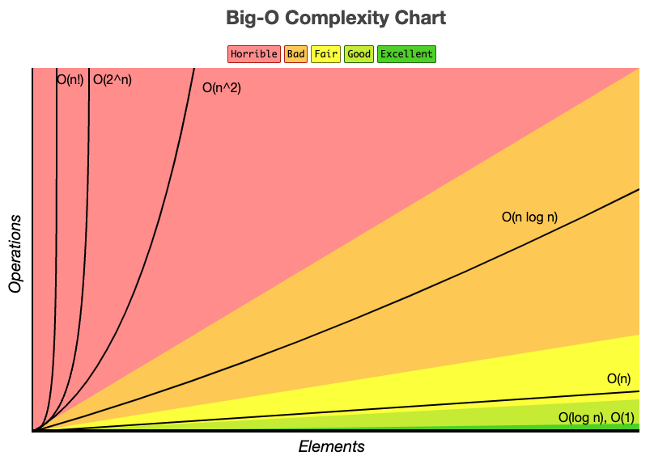
Big-O Complexity Chart

Slide 25
Big-O Constant Time
X = 5 + (15 * 20)
Independent of input size, N
O(1): “Big Oh of one”
X = 5 + (15 * 20);
Y = 15 – 5;
Print x + y;
Total time = O(1) + O(1) + O(1) = 3 * O(1) = O(1)

Slide 26
Big-O Linear Time
For x in range (0, n): print x; // O(1)
N * O(1)
O(N)
X = 5 + (15 * 20); O(1)
For x in range (0, n): print x; O(N)
Total time = O(1) + O(N)
Total time = O(N)

Slide 27
Big-O Quadratic Time
X = 5 + (15 * 20); O(1)
For x in range (0, n): print x; O(N)
For x in range (0, n): for y in range (0, n): print x * y; O(N²)

Slide 28
Exercise
If x > 0: // O(1) else if x < 0: // O(logn) else: // O(n²)
O(?)

Slide 29
Exercise
If x > 0: // O(1) else if x < 0: // O(logn) else: // O(n²)
O(n²)

Slide 30
Comparison
Big O notation (Worst-case)
Big Omega Ω notation (Best-case)
Big Theta Θ notation (Average-case)

Slide 31



Comparison
Upper bound
F(n)
Lower bound

Slide 32
Comparison
F(n) = O(g(n)) iff f(n) <= c * g(n)
F(n) = Ω(g(n)) iff f(n) >= c * g(n)
F(n) = Θ(g(n)) iff c1 * g(n) <= f(n) <= c2 * g(n)

Slide 33
Extra Examples
X = 5 + (15 * 20);
For x in range (0, n): print x;
For y in range (0, n): print y;
O(n)

Slide 34
Extra Examples
If(condition) { ……. O(n) } else { ……. O(n²) }
O(n²)

Slide 35
Space Complexity
Amount of space int: 4 B { int a, b, c; int z = a + b + c; return(z); }
CONSTANT SPACE
= 4 * 4 + 4
= 20 B
Notes:
+ 4 is for the return statement

